Slide 1
Data Analytics Intro
Prashant Sahu
B.Tech., PhD (IIT Bombay, ongoing)
prashant.sahu@iitb.ac.in; prashant9501@gmail.com
988 171 9501

Slide 2
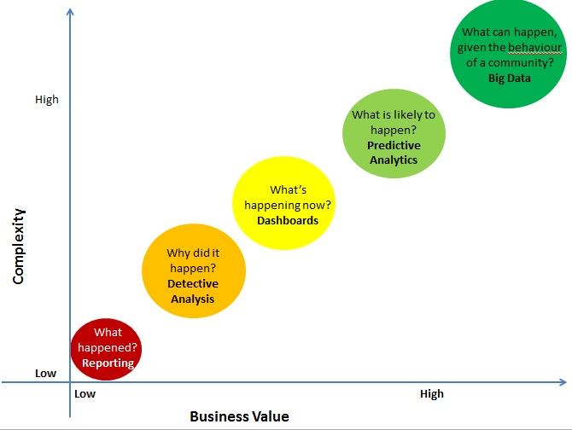
Data Analytics Spectrum

Slide 3
Predictive Analytics 360⁰
Progress Path
Typical Application Areas
Definitions
Data Modeling Life Cycle
Tools
Algorithms
Technology
Data, Data, Data

Slide 4
Predictive Analytics 360⁰
Typical Application Areas:
Financial : Financial data, collected in the banking and financial industry are often relatively complete, reliable, and of high quality, which facilitates systematic data analysis and data mining. A few typical cases:
Loan payment prediction and customer credit policy analysis.
Classification and clustering of customers for targeted marketing.
Detection of money laundering and other financial crimes.
Automated trading systems
Credit Scoring
Risk management
Underwriting
Fraud detection
Collection analytics

Slide 5
Predictive Analytics 360⁰
Typical Application Areas:
Retail Industry: The retail industry is a major application area for data mining, since it collects huge amounts of data on sales, customer shopping history, goods transportation, consumption and service. Retail data mining can help identify customer buying behaviors, discover customer shopping patterns and trends, improve the quality of customer service, achieve better customer retention and satisfaction, enhance goods consumption ratios, design more effective goods transportation and distribution policies, and reduce the cost of business.
Multidimensional analysis of sales, customers, products, time, and region.
Analysis of the effectiveness of sales campaigns.
Customer retention—analysis of customer loyalty.
Product recommendation and cross-referencing of items.
Market basket analysis

Slide 6
Predictive Analytics 360⁰
Typical Application Areas:
Telecommunication Industry: The telecommunication industry provides local and long distance telephone services and many other comprehensive communication services, including fax, pager, cellular phone, Internet messenger, images, e-mail, computer and Web data transmission, and other data traffic. Data Mining Applications:
Multidimensional analysis of telecommunication data.
Fraudulent pattern analysis and the identification of unusual patterns.
Multidimensional association and sequential pattern analysis.
Mobile telecommunication services.
Use of visualization tools in telecommunication data analysis .
Tools for OLAP visualization, linkage visualization, association visualization, clustering, and outlier visualization have been shown to be very useful for telecommunication data analysis.

Slide 7
Predictive Analytics 360⁰
Typical Application Areas:
Biological Data Analysis: Explosive growth in genomics, proteomics, functional genomics, and biomedical research. Examples are the identification and comparative analysis of the genomes of human and other species (by discovering sequencing patterns, gene functions, and evolution paths), the investigation of genetic networks and protein pathways and the development of new pharmaceuticals and advances in cancer therapies. This is a new research field called bioinformatics.
Semantic integration of heterogeneous, distributed genomic and proteomic databases.
Alignment, indexing, similarity search, and comparative analysis of multiple nucleotide/protein sequences.
Discovery of structural patterns and analysis of genetic networks and protein pathways.
Association and path analysis:
identifying co-occurring gene sequences and linking genes to different stages of disease development.
Visualization tools in genetic data analysis: Alignments among genomic or proteomic sequences and the interactions among complex biological structures are most effectively presented in graphic forms, transformed into various kinds of easy-to-understand visual displays. Such visually appealing structures and patterns facilitate pattern understanding, knowledge discovery, and interactive data exploration.

Slide 8
Predictive Analytics 360⁰
Typical Application Areas:
Intrusion Detection: The security of computer systems and data is at continual risk. Because of growth of the Internet and increasing availability of tools and tricks for intruding and attacking networks, intrusion detection has become a critical component of network administration. An intrusion is any set of actions that threaten the integrity, confidentiality, or availability of a network resource (such as user accounts, file systems, system kernels, and so on). In comparison to traditional intrusion detection systems, intrusion detection systems based on data mining are generally more precise and require far less manual processing and input from human experts.
Development of data mining algorithms for intrusion detection:
Association and correlation analysis, and aggregation to help select and build discriminating attributes:
Analysis of stream data:
Distributed data mining:
Visualization and querying tools: Visualization tools should be available for viewing any anomalous patterns detected. Such tools may include features for viewing associations, clusters, and outliers. Intrusion detection systems should also have a graphical user interface that allows security analysts to pose queries regarding the network data or intrusion detection results.

Slide 9
Predictive Analytics 360⁰
Typical Application Areas:
Classification by Object Recognition in Satellite Images: Remotely sensed images have a lot of geographical information inside. Geographical information can be useful for different sectors like government, business, science, engineering and research institutes. An automatic mechanism is provided based on object recognition by Data Mining to extract objects from the image and then do classification of the image.
Geographical information can be used :
for city and regional planning,
analysis of natural resources in an area and
improvement in vegetation of an area.
Agricultural Monitoring /Modeling e.g., cultivated vs. non-cultivated areas, types of crops, varieties, ground deformations
mining satellite images may help detect forest fire,
find unusual phenomena on earth,
predict hurricane landing site, discover weather patterns, and
outline global warming trends.

Slide 10
Predictive Analytics 360⁰
Typical Applications:
Business: Most business processes in most organizations have the potential to benefit from predictive modeling. That said, there are certain situations where predictive models can be especially beneficial in delivering a great deal of value:
Processes that require a large number of similar decisions
Where the outcomes have a significant impact, i.e., where there’s a lot at stake in terms of money or lives
Where there’s abundant information in electronic data form available on which to base decisions and measure outcomes
Where it’s possible to insert a model calculation into the actual business process, either to automate decisions or to support human decision makers
CRM related: Analytical customer relationship management (CRM) ,Clinical decision support systems ,Cross-sell, Customer retention ,Direct marketing.
Portfolio, product or economy-level prediction

Slide 11
Predictive Analytics 360⁰
Typical Applications:
Automated controls and recognition include :
the system identification and control (vehicle control, process control, natural resources management),
quantum chemistry,
game-playing and decision making (backgammon, chess, poker),
pattern recognition (radar systems, face identification, object recognition and more),
sequence recognition (gesture, speech, handwritten text recognition),
Natural Language processing, text mining and e-mail spam filtering.

Slide 12
Predictive Analytics 360⁰
Typical Applications:
Web searching/ mapping/ social networking: Web Content Mining, Web Structure Mining, and Web Usage Mining.
Change in our lives in the decade following the turn of the century was the availability of efficient and accurate Web search, through search engines such as Google.
Much information is gained by analyzing the large-scale data derived from social networks. It is important in a social network is how to identify communities, i.e., subsets of the nodes (people or other entities that form the network) with unusually strong and usually overlapping connections.
Social networks are naturally modeled as graphs, which are called social graph. Types: Telephone, Email , Collaboration , information (documents, web graphs, patents), infrastructure (roads, planes, water pipes, power grids), biological (genes, proteins, food-webs of animals eating each other), as well as other types, like product co-purchasing(e.g., Group on) networks.

Slide 13
Predictive Analytics 360⁰
Typical Applications:
Social network
When we think of a social network, we think of Facebook, Twitter, Google+, or another website that is called a “social network.” Characteristics are:
There its a collection of entities that participate in the network.
There is at least one relationship between entities of the network.
There is an assumption of non randomness or locality.
broad applications, are
social network analysis, web community discovery,
terrorist network mining,
computer network analysis, and
network intrusion detection.

Slide 14
Predictive Analytics 360⁰
Progress Path
Typical Application Areas
Definitions
Algorithms
Tools
Data Modeling Life Cycle
Technology
Data, Data, Data

Slide 15
Predictive Analytics 360⁰
Definitions
Definitions
History
Statistics Base

Slide 16
Predictive Analytics 360⁰
Introduction-Definitions
The application of learning algorithms and statistical methods to real-world datasets is “Predictive Analytics”-PA. Actually it is first analysis and then prediction.
The other side to predictive analytics- PA is called descriptive analytics which is to discover patterns in data. Descriptive and predictive analytics together are often called “knowledge discovery in data” or KDD. Insight, not hindsight is the essence of predictive analytics. Knowledge Discovery in Data is the non-trivial process of identifying
valid
novel
potentially useful
and ultimately understandable patterns in data.
The way predictive models produce value is simple in concept:
Make it possible to make more right decisions, more quickly, and with less expense.
Provide support for human decisions, making them more efficient and effective, or in some cases,
Can be used to automate an entire decision-making process.

Slide 17
Predictive Analytics 360⁰
Introduction-Definitions
Predictive Analytics is also interchangeably used with Machine learning, Data Mining, Artificial Intelligence (Neural Networks)
Machine Learning- two definitions
Arthur Samuel described it as: "the field of study that gives computers the ability to learn without being explicitly programmed.
Tom Mitchell provides a more modern definition: "A computer program is said to learn from experience E with respect to some class of tasks T and performance measure P, if its performance at tasks in T, as measured by P, improves with experience E.“

Slide 18
Predictive Analytics 360⁰
Introduction-Definitions
Two types of learning
Supervised Learning - In supervised learning, we are given a data set and already know what our correct output should look like, having the idea that there is a relationship between the input and the output.
Unsupervised learning, on the other hand, allows us to approach problems with little or no idea what our results should look like. We can derive structure from data where we don't necessarily know the effect of the variables.

Slide 19
Predictive Analytics 360⁰
History
Statistics limited use over the entire 20th century, due to complexity of algorithms and inability to compute large scale data
Recent rapid development of computer and information changed almost every field, transforming from data-poor to increasingly data-rich.
development of database methods to manage peta bytes of data online, safe accessibility via the Internet and/or a computing grid, powerful data mining tools to analyze such data.

Slide 20
Predictive Analytics 360⁰
History
Data mining, has progressed the confluence of statistics, machine learning, pattern recognition, database systems, information retrieval, World-Wide Web, visualization, and many application domains,
learning from data has led to a revolution in the statistical sciences due to computation done by researchers in computer science and engineering.
The future belongs to the companies and people that turn data into products

Slide 21
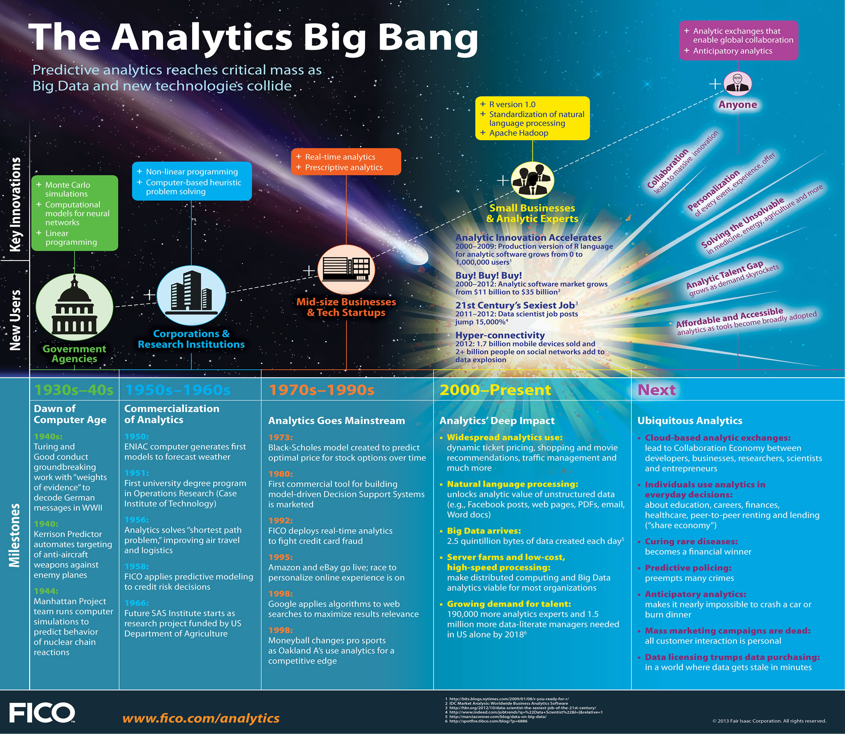
Predictive Analytics 360⁰
History

Slide 22
Predictive Analytics 360⁰
Statistical/ Mathematical Base of Predictive Analytics
Gaussian, T, Z probability distributions
T, Z, F, Chi squared tests for hypothesis testing
Statistical significance / Confidence interval / p-value
Anova / Manova
Correlation, Pearson’s Correlation Coefficient (r), The Coefficient of Determination = r2.
Univariate / Multivariate / Linear / Polynomial regression models

Slide 23
Predictive Analytics 360⁰
Statistical/ Mathematical Base of Predictive Analytics
Overfitting and Under fitting/ bias vs. variance
Logistic regression – Sigmoid function
Least squared and nearest neighbor methods
Boosting AdaBoost, Gradient descent, Numerical optimisation, Statistical Estimation
Linear / Matrix Algebra
Calculus

Slide 24
Predictive Analytics 360⁰
Progress Path
Typical Application Areas
Introduction
Algorithms
Data Modeling Life Cycle
Tools
Technology
Data, Data, Data

Slide 25
Predictive Analytics 360⁰
Progress Path
Algorithms
Types of tasks
List of popular Algorithms
Regression models- linear/ polynomial
Logistic Regression
Artificial Neural Networks
Parametric vs. nonparametric
Common considerations
Data Preparation
Evaluation of performance
Debugging

Slide 26
Predictive Analytics 360⁰
Algorithms
A set of independent variables are used to predict a value of a dependent variable (which is either category labels or a continuous variable)
To predict the behavior of concepts, persons, entities such as profit, turnover, customer, supplier, employee, lonee etc. with the help of features which are fields of the same record ranging from a few to millions and a number of examples again ranging form 20 to millions
If we consider a table in RDBMS, each record is an example of the concept described in the table and the fields are either dependent or independent variables which may be called as features.
These tasks are carried out with a set of processes called Algorithms

Slide 27
Predictive Analytics 360⁰
Algorithms
Types of tasks: classification, prediction, association, and clustering
Classification is the process of finding a model (or function) that describes and distinguishes data classes or concepts, for the purpose of being able to use the model to predict the class of objects whose class label is unknown.
The derived model may be represented in various forms, such as classification (IF-THEN) rules, decision trees, mathematical formulae, or neural networks.
Prediction is the process of modeling continuous-valued functions. That is, it is used to predict missing or unavailable numerical data values rather than class labels.
The process of finding frequent patterns leads to the discovery of interesting associations and correlations within data e.g. A frequent item set, A frequent sequence or a frequent time series etc.
Unlike classification and prediction which analyze class-labeled data objects, clustering process analyzes data objects without consulting a known class label.

Slide 28
Predictive Analytics 360⁰
Algorithms
Two types: Supervised, Unsupervised.
Supervised learning algorithm is inferring a function from labeled training data. The training data is divided into three sets- training, validating and testing. In supervised learning, each example is a pair consisting of an input feature/s (typically a vector) and a desired output value (also called the supervisory signal). A supervised learning algorithm analyzes the training data and produces an inferred function, which is tested and validated before it is used for mapping new examples. An optimal scenario will allow for the algorithm to correctly determine the class labels for unseen instances.
Problems with this algorithm are overfitting-the output function, i.e., fits the training data very well but can not predict the test data correctly-and under fitting where the function does neither fit the training data nor the test data. Various methods are available to combat these issues.
Unsupervised learning algorithms try to find hidden structure in unlabeled data. Clustering is the task of grouping a set of objects in such a way that objects in the same group (called a cluster) are more similar (in some sense or another) to each other than to those in other groups (clusters).

Slide 29
Predictive Analytics 360⁰
Algorithms
Some popular supervised algorithms:
Neural Networks
Naive Bayes
Nearest Neighbor
Regression models
Support Vector Machines (SVMs)
Decision Trees
Some popular unsupervised algorithms:
K-nearest neighbor
Neural network based approaches for meeting a threshold

Slide 30
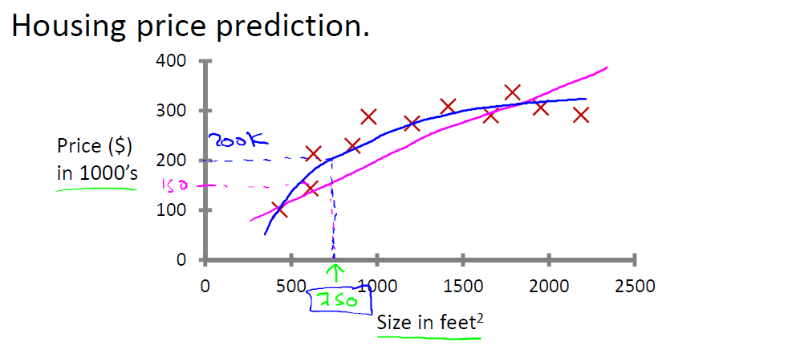
Predictive Analytics 360⁰
Algorithms – Regression models
Supervised Learning “right answers” given. The red crosses are the given answers
Regression: Predict continuous valued output=price, one feature = size
Function: price = a + b*size --- Linear Generalised: a + b₁*x₁ + b₂*x₂ … b _{n} * x_{n}
Multiple features are generally used. Can not be plotted
Function: price = a + b* price²
Magenta: Linear- under fitting
Green: binomial- over fit
Blue: Polinimial- right fit

Slide 31
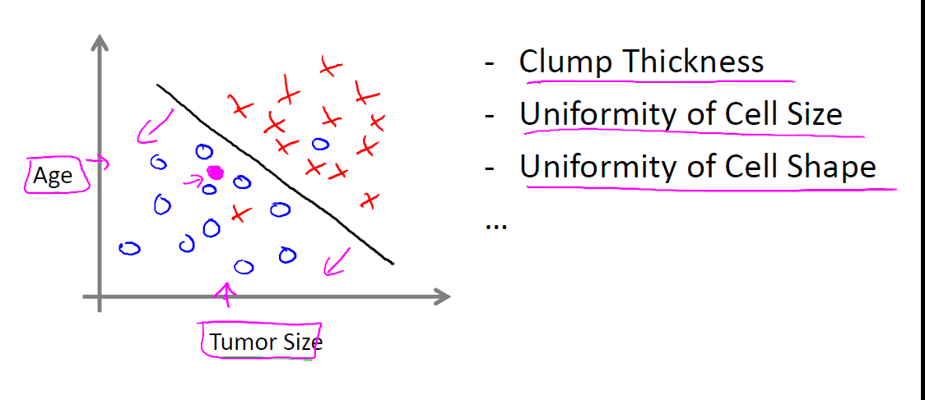
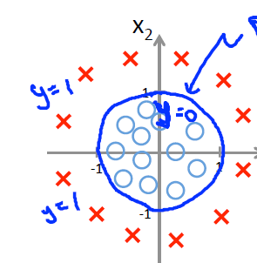
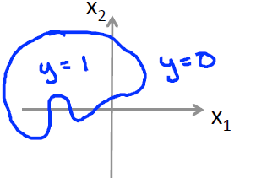
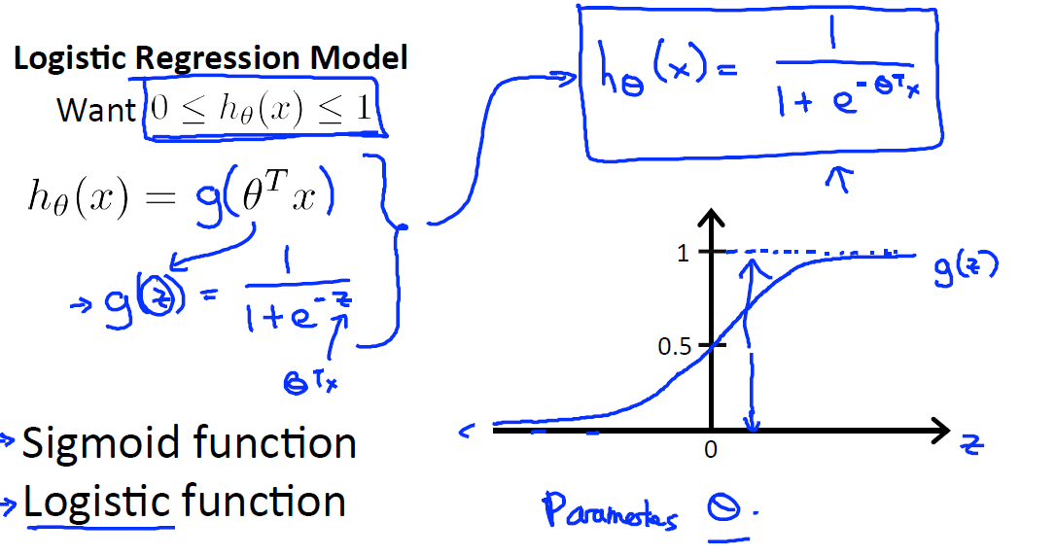
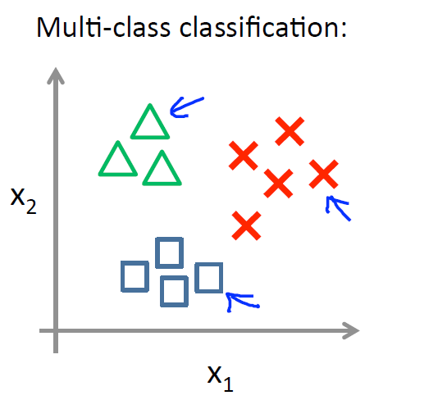
Predictive Analytics 360⁰
Algorithms: Logistic regression
The dependent variable is category, e.g. tumor malignant or benign
Decision boundary- linear, Binomial, Polinomial

Slide 32
Predictive Analytics 360⁰
Algorithms- Artificial Neural Networks-A
systems of interconnected "neurons" which can compute values from inputs, and are capable of machine learning as well as pattern recognition thanks to their adaptive nature.
slightly advance algorithm we will not see it in details
ANNs are a family of statistical learning algorithms inspired by biological neural networks are used
to estimate or approximate functions that can depend on a large number of inputs and are generally unknown.
to solve a wide variety of tasks that are hard to solve using ordinary rule-based programming, including computer vision and speech recognition.
when the decision boundary becomes more complex and the calculations become complicated and complex for Logistic regression.
for classification in place of Logistic regression.

Slide 33
Predictive Analytics 360⁰
Algorithms- Support Vector Machine-SVM
SVM is a very powerful and widely used supervised learning algorithm. It is also called large margin classifier. The decision boundary has the max distance from any of the training example.
As compared to LR and ANN the SVM works cleaner and sometimes more powerful learning.
The choice really depends on the size of the number of features-n and number of examples-m available in the data. Recommended:
If n (1-10000)>> m(10-1000) use LR or SVM with Linear Kernel
If n (1-1000), m(10-10000 or upto 50000) use SVM with Gaussian Kernel
If n (1-1000), m(50000+ upto million+) use SVM with linear kernel or add more features manually and use LR.
ANN will be useful in all the cases but will run slower

Slide 34
Predictive Analytics 360⁰
Algorithms –Parametric vs. non parametric
The algorithms discussed up to now are parametric meaning they try to discover the function from a function space of the nature:
a + b₁x₁⁰ + ……+b_{n}x_{n}^{N} where n can take any value from 0 to any large number and N can also take any number 0 to some fairly large number. Here xes are the features and bs are the parameters.
There are other class of algorithms which are non parametric such as Naïve Bayes, K nearest neighbor, Decision trees etc.
Parametric algorithms (or models) assume known distributions in the data. Many parametric algorithms and statistical tests, although not all, assume normal distributions and find linear relationships in the data.

Slide 35
Predictive Analytics 360⁰
Algorithms –Parametric vs. non parametric
The advantage of parametric models is that if the distributions are known, extensive properties of the data are also known and therefore algorithms can be proven to have very specific properties related to errors, convergence, and certainty of learned coefficients.
Because of the assumptions, however, the analyst often spends considerable time transforming the data so that these advantages can be realized.
Non-parametric models are far more flexible because they do not have underlying assumptions about the distribution of the data, saving the analyst considerable time in preparing data. However, far less is known about the data a priori, and therefore non-parametric algorithms are typically iterative, without any guarantee that the best or optimal solution has been found.

Slide 36
Predictive Analytics 360⁰
Algorithms-Common considerations- Data preparation
Complexity of calculations-Libraries
Though the computation involved in developing PA models is complex the tools like R programming and other proprietary tools are rich in libraries.
The data has to be properly prepared and handed over to the tools.
The tools produce solutions and also give a lot of data for interpreting them.
Data Preprocessing:
Binning: Binning methods replace a value by a "bin number" defined by all elements of its neighborhood, that is, the bin it belongs to.
Conversion of Category Type to Binary Vector
Inter-Quartile Range Test, Variance Test : Identify and treat outliers

Slide 37
Predictive Analytics 360⁰
Algorithms-Common considerations- Data preparation
Partition: The algorithm partitions an input dataset randomly into three disjoints subsets called training, testing, and validation set.
Dimensionality reduction- Principal Component Analysis (PCA) -data compression- reduce 2D to 1 D , 3D to 2D, 50D to 2D
Feature scaling- Get every feature variable on same scale by dividing it by range
Mean normalisation-subtract mean from feature and divide by range
Regularization-
Keep all the features, but reduce magnitude/values of parameters .
Works well when we have a lot of features, each of which contributes a bit to predicting .

Slide 38
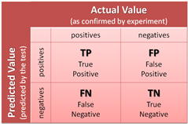
Predictive Analytics 360⁰
Algorithms-Common considerations-Evaluation of the performance
Diagnostics: A test to gain insight as to what is/ isn’t working and gain guidance as to how best to improve performance. Diagnostic can take time but this is better spent rather than taking actions based on gut feel.
Low training error is not always good as it may be overfitting and not predict test data correctly.
Confusion matrix:

Slide 39

Predictive Analytics 360⁰
Evaluation-Precision/Recall
y=1 in presence of rare class that we want to detect
Precision
(Of all patients where we predicted , what fraction actually has cancer?)
Recall
(Of all patients that actually have cancer, what fraction did we correctly detect as having cancer?)

Slide 40
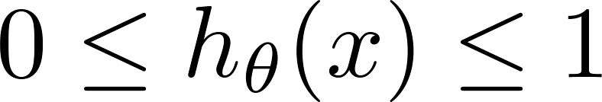



Predictive Analytics 360⁰
Trading off precision and recall
precision =
true positives
Logistic regression:
Predict 1 if
Predict 0 if
no. of predicted positive
true positives
recall =
no. of actual positive
Suppose we want to predict (cancer)
only if very confident.
1
Precision
0.5
Suppose we want to avoid missing too many cases of cancer (avoid false negatives).
0.5
1
Recall
More generally: Predict 1 if threshold.

Slide 41
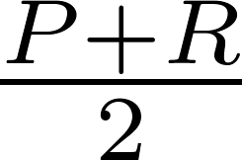
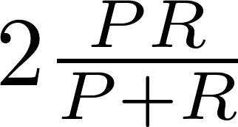
Predictive Analytics 360⁰
F₁ Score (F score)
How to compare precision/recall numbers?
 | Precision(P) | Recall (R) | Average | F₁ Score
Algorithm 1 | 0.5 | 0.4 | 0.45 | 0.444
Algorithm 2 | 0.7 | 0.1 | 0.4 | 0.175
Algorithm 3 | 0.02 | 1.0 | 0.51 | 0.0392
Average:
F₁ Score:

Slide 42
Predictive Analytics 360⁰
Algorithms-Common considerations-Evaluation of the performance
To evaluate performance first take the following actions:
Split data records in train (60%), validate(20%) and test (20%)
Calculate training error on all the three
The following scenarios will appear
Bias related errors
If high bias error training error and validation error both will high
If high variance error training error will be low and validation error will be high
Regularisation related errors
Higher value of regularisation parameter end up in high bias error in training and validation set
Lower value of regularisation parameter end up in lower bias error in training set and high error in validation set
Intermediate value of regularisation will be just right

Slide 43
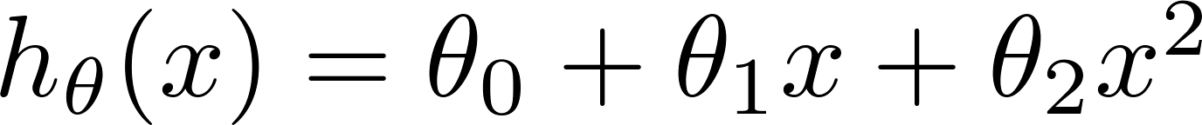
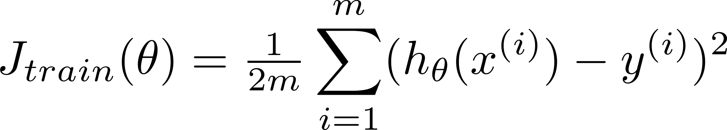
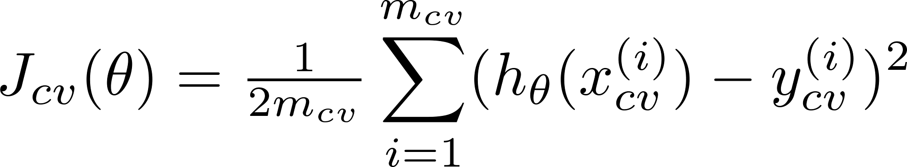
Predictive Analytics 360⁰
Learning curves
error
(training set size)

Slide 44

Predictive Analytics 360⁰
High bias
price
error
size
(training set size)
price
If a learning algorithm is suffering from high bias, getting more training data will not (by itself) help much.
size

Slide 45
Predictive Analytics 360⁰
High variance
(and small )
error
price
size
(training set size)
price
If a learning algorithm is suffering from high variance, getting more training data is likely to help.
size

Slide 46
Predictive Analytics 360⁰
Neural networks and overfitting
“Small” neural network
(fewer parameters; more prone to underfitting)
“Large” neural network
(more parameters; more prone to overfitting)
Computationally cheaper
Computationally more expensive.
Use regularization ( ) to address overfitting.

Slide 47
Predictive Analytics 360⁰
Algorithms-Common considerations- Debugging
Choose where to spend time:
When algorithm is OK on training data but produces large errors on test data possible actions are
Get more training examples
Try smaller set of features
Get additional features
Add polynomial features
Change regularisation parameter
Which one to choose under what case?

Slide 48
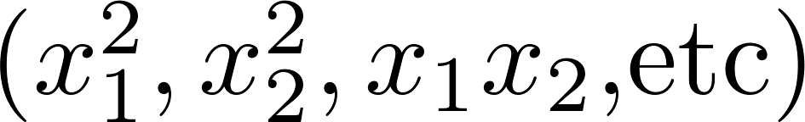
Predictive Analytics 360⁰
Debugging a learning algorithm:
Get more training examples
Try smaller sets of features
Try getting additional features
Try adding polynomial features
Try decreasing
Try increasing

Slide 49
Predictive Analytics 360⁰
Progress Path
Typical Application Areas
Definitions
Algorithms
Tools
Data Modeling Life Cycle
Technology
Data, Data, Data

Slide 50
Predictive Analytics 360⁰
Tools :
numerous tools range from needing very little user sophistication to that are designed for the expert practitioner. The difference is in the level of customization and heavy data lifting allowed.
Notable open source predictive analytic tools include:
scikit-learn-Python
KNIME
Open NN
Orange
R
Rapid Miner
GNU Octave
Apache Mahout
Weka
Notable commercial predictive analytic tools include:
Alpine Data Labs
BIRT Analytics
Angoss
Knowledge STUDIO
IBM SPSS Statistics and IBM SPSS Modeler
KXEN Modeler
Mathematica
MATLAB
Minitab
Oracle Data Mining
Pervasive
Predixion Software
RCASE
Revolution Analytics
SAP
SAS and
SAS Enterprise Miner
STATA
STATISTICA
TIBCO

Slide 51
Predictive Analytics 360⁰
Progress Path
Typical Application Areas
Introduction
Algorithms
Tools
Data Modeling Life Cycle
Technology
Data, Data, Data

Slide 52
Predictive Analytics 360⁰
Progress Path
Data Modeling
Definition
Six phases of model development process
Precautions in Modeling
Relative importance of and time required by phases
Limitations
Barriers to Usage

Slide 53
Predictive Analytics 360⁰
Predictive modeling : Definition
A predictive model is an attempt to relate one set of variables to another, a representation of the world, a rendering or description of reality.
Whether forecasting sales or market share, finding a good retail site or investment opportunity, identifying consumer segments and target markets, or assessing the potential of new products or risks associated with existing products, modeling methods in predictive analytics provide the key.
Predictive models bring management, information technology, including data structures, algorithms and statistical techniques together.

Slide 54
Predictive Analytics 360⁰
Predictive modeling : Definition
Models describe the relationship between all the elements of a decision — the known data (including results of predictive models), the decision and the forecast results of the decision — in order to predict the results of decisions involving many variables . These models can be used in optimization, maximizing certain outcomes while minimizing others.
Model development follows a six phase process to achieve the desired results

Slide 55
Predictive Analytics 360⁰
Six phases of predictive analytics model development process
Business understanding. understand the project objectives and requirements from a business perspective, convert this knowledge into a data mining problem definition and a preliminary plan designed to achieve the objectives.
• Data understanding. initial data collection ,get familiar with the data, to identify data quality problems, to discover first insights into the data or to detect interesting data subsets to form hypotheses for hidden information.
• Data preparation. to construct the final data set. Tasks include instance and attribute selection , transformation and cleaning of data for modeling tools, likely to be performed multiple times and not in any prescribed order.

Slide 56
Predictive Analytics 360⁰
Six phases of predictive analytics model development process
Modeling. data mining techniques are selected and applied and their parameters calibrated to optimal values. Some techniques have specific requirements on the form of the data. Therefore, stepping back to the data preparation phase is often necessary.
• Evaluation. An analysis of the developed model to ensure that it achieves the business objectives. A decision on the use of the data mining result is reached.
• Deployment. simple as generating a report or as complex as implementing a repeatable data mining process across the enterprise. Lot of organisational politics and interested persons opposition needs to be overcome. A tricky phase. All the efforts may go down the drain if not properly handled.

Slide 57
Predictive Analytics 360⁰
Six phases of predictive analytics model development process

Slide 58
Predictive Analytics 360⁰
Precautions in Modeling :
The domain must involve numerous individual cases.
There should be a clear objective to be optimized.
The actions should be definable that can be taken with respect to each case that influence the objective.
There should be an unknown target value that is relevant to the objective that can be predicted for each case.
The target value should be known for numerous historical cases.
Features of each case should be seen that are correlated with the target value.
The cases should be reasonably independent.

Slide 59
Predictive Analytics 360⁰
Relative importance of and time required by phases
On clear Business objective are dependant all further actions and carried out to fulfill the same. Well begun is half done.
Data preparation phase occupies a large part of the project as
The data come from various sources, need to be formatted and assembled.
data should be cleaned of missing values, outliers.
Time taken to execute the algorithm is small but requires iterations a few times by selecting or deleting features, additional examples may be required and more than one algorithm need to be tried before arriving at the desired level of acceptance. This is the work horse.
After training the algorithm on the past data, the proof is in the acceptable performance on future data is very important, else the effort may be needed to iterate.
Selling the developed solution is many times essential as the new solutions can easily get ignored.
Big data technology will bring a whole set of new processes such as PIG, Hive, mapReduce, hadoop etc.(discussed later)

Slide 60
Predictive Analytics 360⁰
Limitations of predictive analytics Modeling:
a dataset for training of adequate size and quality. The predictive analysis to be statistically significant, sufficient data must be available.
the training data must be representative of the test data. Typically, the training data come from the past, while the test data arise in the future. If the phenomenon to be predicted is not stable over time, then predictions are likely not to be useful
“Big data gives you a false sense of security.”
a clear definition of the concept that is to be predicted, and to have historical examples of the concept. - Data mining cannot read minds.
the actions to be taken based on predictions need to be defined clearly and to have reliable profit consequences. .
dangerous as it can lead to missing qualitative issues.
can lead to an ever-increased focus on optimizing existing processes, at the expense of understanding the broader situation.

Slide 61
Predictive Analytics 360⁰
Barriers to Usage. A host of barriers can prevent organizations from venturing into the domain of predictive analytics or impede their growth. This “analytics bottleneck” arises from:
1. Complexity..
2. Data.
3. Processing Expense.
4. Expertise.
5. Interoperability.
6. Pricing.
Fortunately, these barriers are beginning to fall, thanks to advances in software, computing, and database technology.

Slide 62
Predictive Analytics 360⁰
Progress Path
Typical Application Areas
Definitions
Algorithms
Tools
Data Modeling Life Cycle
Technology
Data, Data, Data

Slide 63
Predictive Analytics 360⁰
Progress Path
Technology
Big Data Definitions
5 V’s of Big Data
Big Data 5 parts
Big Data Models
Big Data Architecture Framework
Big data MapReduce and Hadoop

Slide 64
Predictive Analytics 360⁰
Technology: Big Data definition
the relevance of predictive analytics has increased with increase in the data sizes-so huge that BIG DATA has become almost a new discipline of the industry bringing with it different technologies.
Big Data refers to datasets whose size is beyond the typical database software tools to capture, store, manage and analyse. What is considered to be "Big" in one year will become ordinary in later years.

Slide 65
Predictive Analytics 360⁰
Technology: Big Data definition
Big data typically refers to the following types of data:
Traditional enterprise data – includes customer information from CRM systems, transactional ERP data, web store transactions, and general ledger data.
Machine-generated /sensor data – includes Call Detail Records (“CDR”), weblogs, smart meters, manufacturing sensors, equipment logs (often referred to as digital exhaust), trading systems data.
Social data – includes customer feedback streams, micro-blogging sites like Twitter, social media platforms like Facebook.
What are the new technologies?

Slide 66
Predictive Analytics 360⁰
Technology: Big Data definitions-
IDC definition (conservative and strict approach) of Big Data: "A new generation of technologies and architectures designed to economically extract value from very large volumes of a wide variety of data by enabling high-velocity capture, discovery, and/or analysis“
Big data is high-volume, high-velocity and high-variety information assets that demand cost effective, innovative forms of information processing for enhanced insight and decision making. Gartner– Termed as 3 parts definition, not 3V definition
Big Data: A massive volume of both structured and unstructured data that is so large that it's difficult to process using traditional database and software techniques. – From “The Big Data Long Tail” blog post by Jason Bloomberg (Jan 17, 2013).

Slide 67
Predictive Analytics 360⁰
Technology: Big Data definitions-
“Data that exceeds the processing capacity of conventional database systems. The data is too big, moves too fast, or doesn’t fit the structures of your database architectures. To gain value from this data, you must choose an alternative way to process it.” – Ed Dumbill, program chair for the O’Reilly Strata Conference
Fourth Paradigm: “The techniques and technologies for such data-intensive science are so different that it is worth distinguishing data-intensive science from computational science as a new, fourth paradigm for scientific exploration., the first three paradigms being experimental, theoretical and (more recently) computational science.” (Jim Gray, computer scientist)

Slide 68
Predictive Analytics 360⁰
Technology: 5 V’s of Big Data
Volume
Terabytes • Records/Arch • Transactions • Tables, Files
Velocity
Batch • Real/near-time • Processes • Stream
Variety
Structured • Unstructured • Multi-factor • Probabilistic
Value
Statistical • Events • Correlations • Hypothetical
Veracity
Trustworthiness • Authenticity • Origin, Reputation • Availability • Accountability

Slide 69
Predictive Analytics 360⁰
Technology: Big Data 5 parts
Big Data Properties: 5V – Volume, Variety, Velocity, Value, Veracity – Additionally: Data Dynamicity (Variability)
New Data Models – Data Lifecycle and Variability – Data linking, provenance and referral integrity
New Analytics – Real-time/streaming analytics, interactive and machine learning analytics
New Infrastructure and Tools – High performance Computing, Storage, Network – Heterogeneous multi-provider services integration – New Data Centric (multi-stakeholder) service models – New Data Centric security models for trusted infrastructure and data processing and storage
Source and Target – High velocity/speed data capture from variety of sensors and data sources – Data delivery to different visualisation and actionable systems and consumers – Full digitised input and output, (ubiquitous) sensor networks, full digital control

Slide 70
Predictive Analytics 360⁰
Technology: Big Data Moving to Data-Centric Models and Technologies
Current IT and communication technologies are host based or host centric
– Any communication or processing is bound to host/computer that runs software
– Especially in security: all security models are host/client based
• Big Data requires new data-centric models
– Data location, search, access
– Data security and access control
– Data integrity and identifiability

Slide 71
Predictive Analytics 360⁰
Technology: Big Data Architecture Framework (BDAF) suggested by University of Amsterdam. (Various organisations like, Microsoft, IBM, Oracle, EMC, SAP have suggested their own framework.)
Data Models, Structures, Types – Data formats, non/relational, file systems, etc.
Big Data Management –
Big Data Lifecycle (Management) Model
Big Data transformation/staging massively parallel software running on tens, hundreds, or even thousands of servers
Provenance, Curation, Archiving
Big Data Analytics and Tools – Big Data Applications ,Target use, presentation, visualisation
Big Data Infrastructure (BDI) – Storage, Compute, (High Performance Computing,) Network – Sensor network, target/actionable devices – Big Data Operational support/ massively parallel software running on tens, hundreds, or even thousands of servers
Big Data Security – Data security in-rest, in-move, trusted processing environments

Slide 72
Predictive Analytics 360⁰
Big Data – Architecture
The multiple layer architecture.
The Distributed Parallel architecture distributes data across multiple processing units and parallel processing units provide data much faster, by improving processing speeds.
This type of architecture inserts data into a parallel DBMS, which implements the use of MapReduce and Hadoop frameworks.
This type of framework looks to make the processing power transparent to the end user by using a front end application server.

Slide 73
Predictive Analytics 360⁰
Technology: Big data MapReduce and Hadoop
In 2004, Google published a paper on a process called MapReduce that used such an architecture.
The MapReduce framework provides a parallel processing model and associated implementation to process huge amount of data.
With MapReduce, queries are split and distributed across parallel nodes and processed in parallel (the Map step). The results are then gathered and delivered (the Reduce step).
The framework was very successful. Therefore, an implementation of the MapReduce framework was adopted by an Apache open source project named Hadoop. Hadoop is comprised of two core components: Hadoop File System (HDFS) and MapReduce. HDFS handles storage, and MapReduce processes data.

Slide 74
Predictive Analytics 360⁰
Technology: Big data MapReduce and Hadoop
The beauty of Hadoop is its built-in resiliency to hardware failure and that it spreads its tasks across a cluster of low-cost servers (nodes), freeing the developer from the onerous challenge of managing the scale-out infrastructure. One of the biggest benefits of HDFS is its fault tolerance without losing data.
Most analytic tasks need to combine data in some way. MapReduce abstracts the problem, providing a programmatic model to describe computational requirements over sets of keys and values, such as attribute name and value (“book and author” or “region and temperature”). Those instructions are then translated into physical reads and writes on the various disks where the data is located.
MapReduce is a programming model for parallel processing. It works by breaking the processing into two phases: the map phase and the reduce phase. In the map phase, input is divided into smaller sub problems and processed. In the reduce phase, the answers from the map phase are collected and combined to form the output of the original bigger problem. The phases have corresponding map and reduce functions defined by the developer.

Slide 75
Predictive Analytics 360⁰
Progress Path
Typical Application Areas
Definitions
Algorithms
Tools
Data Modeling Life Cycle
Technology
Data, Data, Data

Slide 76
Predictive Analytics 360⁰
Data, Data, Data-- Speed
Every minute:
Facebook users share nearly 2.5 million pieces of content.
Twitter users tweet nearly 300,000 times.
Instagram users post nearly 220,000 new photos.
YouTube users upload 72 hours of new video content.
Apple users download nearly 50,000 apps.
Email users send over 200 million messages.
Amazon generates over $80,000 in online sales.
Google processes 20 petabytes of information per day.
More than five exabytes of content are created each day.
86 million websites have been built using WordPress.
Greater than 39% of the world’s population uses the internet (2.7 billion people).
Facebook users share nearly 2.5 million pieces of content per minute.
Approximately four billion hours of online video are watched each month.

Slide 77
Predictive Analytics 360⁰
Data Mining—On What Kind of Data?
RDBMS- A Relational database is a collection of tables, each of which is assigned a unique name.
Each table consists of a set of attributes (columns or fields) and usually stores a large set of tuples (records or rows). Each tuple in a relational table represents an object identified by a unique key and described by a set of attribute values.
A semantic data model, such as an entity-relationship (ER) data model, is often constructed for relational databases.
An ER data model represents the database as a set of entities and their relationships.

Slide 78
Predictive Analytics 360⁰
Data Mining—On What Kind of Data?
DataWareHouse -
A Data warehouse is a repository of information collected from multiple
sources, stored under a unified schema, and that usually resides at a
single site. Data warehouses are constructed via a process of data
cleaning, data integration, data transformation, data loading, and
periodic data refreshing.

Slide 79
Predictive Analytics 360⁰
Data Mining—On What Kind of Data?
Transactional Data Base - In general, a transactional database consists of a file where each record represents a transaction. A transaction typically includes a unique transaction identity number (trans ID) and a list of the items making up the transaction (such as items purchased in a store).

Slide 80
Predictive Analytics 360⁰
Data Mining—On What Kind of Data?
Object Oriented RDBMS - Conceptually, the object-relational data model inherits the essential concepts of object-oriented databases, where, in general terms, each entity is considered as an object. Data and code relating to an object are encapsulated into a single unit. Each object has associated with it the following.
A set of variables that describe the objects. These correspond to attributes in the entity-relationship and relational models.
A set of messages that the object can use to communicate with other objects, or with the rest of the database system.
A set of methods, where each method holds the code to implement a message. Upon receiving a message, the method returns a value in response. For instance, the method for the message get photo(employee) will retrieve and return a photo of the given employee object.

Slide 81
Predictive Analytics 360⁰
Data Mining—On What Kind of Data?
A Temporal database typically stores relational data that include time-related attributes. These attributes may involve several timestamps, each having different semantics.
A Sequence database stores sequences of ordered events, with or without a concrete notion of time. Examples include customer shopping sequences, Web click streams, and biological sequences.
A Time-series database stores sequences of values or events obtained over repeated measurements of time (e.g., hourly, daily, weekly). Examples include data collected from the stock exchange, inventory control, and the observation of natural phenomena (like temperature and wind).

Slide 82
Predictive Analytics 360⁰
Data Mining—On What Kind of Data?
Spatial databases contain spatial-related information. Examples include geographic (map) databases, very large-scale integration (VLSI) or computed-aided design databases, and medical and satellite image databases.
Text databases are databases that contain word descriptions for objects. These word descriptions are usually not simple keywords but rather long sentences or paragraphs, such as product specifications, error or bug reports, warning messages, summary reports , notes, or other documents.

Slide 83
Predictive Analytics 360⁰
Data Mining—On What Kind of Data?
Multimedia databases store image, audio, and video data. They are used in applications such as picture content-based retrieval, voice-mail systems, video-on-demand systems, the World Wide Web, and speech-based user interfaces that recognize spoken commands.
A Heterogeneous database consists of a set of interconnected, autonomous component databases. The components communicate in order to exchange information and answer queries.
Legacy Database formed as a result of long history of IT Development. A legacy database is a group of heterogeneous databases that combines different kinds of data systems, such as relational or object-oriented databases, hierarchical databases, network databases, spreadsheets, multimedia databases, or file systems.

Slide 84
Predictive Analytics 360⁰
Data Mining—On What Kind of Data?
Data Streams - Many applications involve the generation and analysis of a new kind of data, called stream data, where data flow in and out of an observation platform (or window) dynamically.
The World Wide Web and its associated distributed information services,
such as Yahoo!, Google, America Online, and AltaVista, provide rich,
worldwide, on-line information services, where data objects are linked
together to facilitate interactive access.

Slide 85
Predictive Analytics 360⁰
Thank You!

Slide 86
Predictive Analytics

Slide 87
Predictive Analytics

Slide 88
Predictive Analytics

Slide 89
Predictive Analytics

Slide 90
Predictive Analytics

Slide 91
Predictive Analytics

Slide 92
Predictive Analytics

